Slide 1
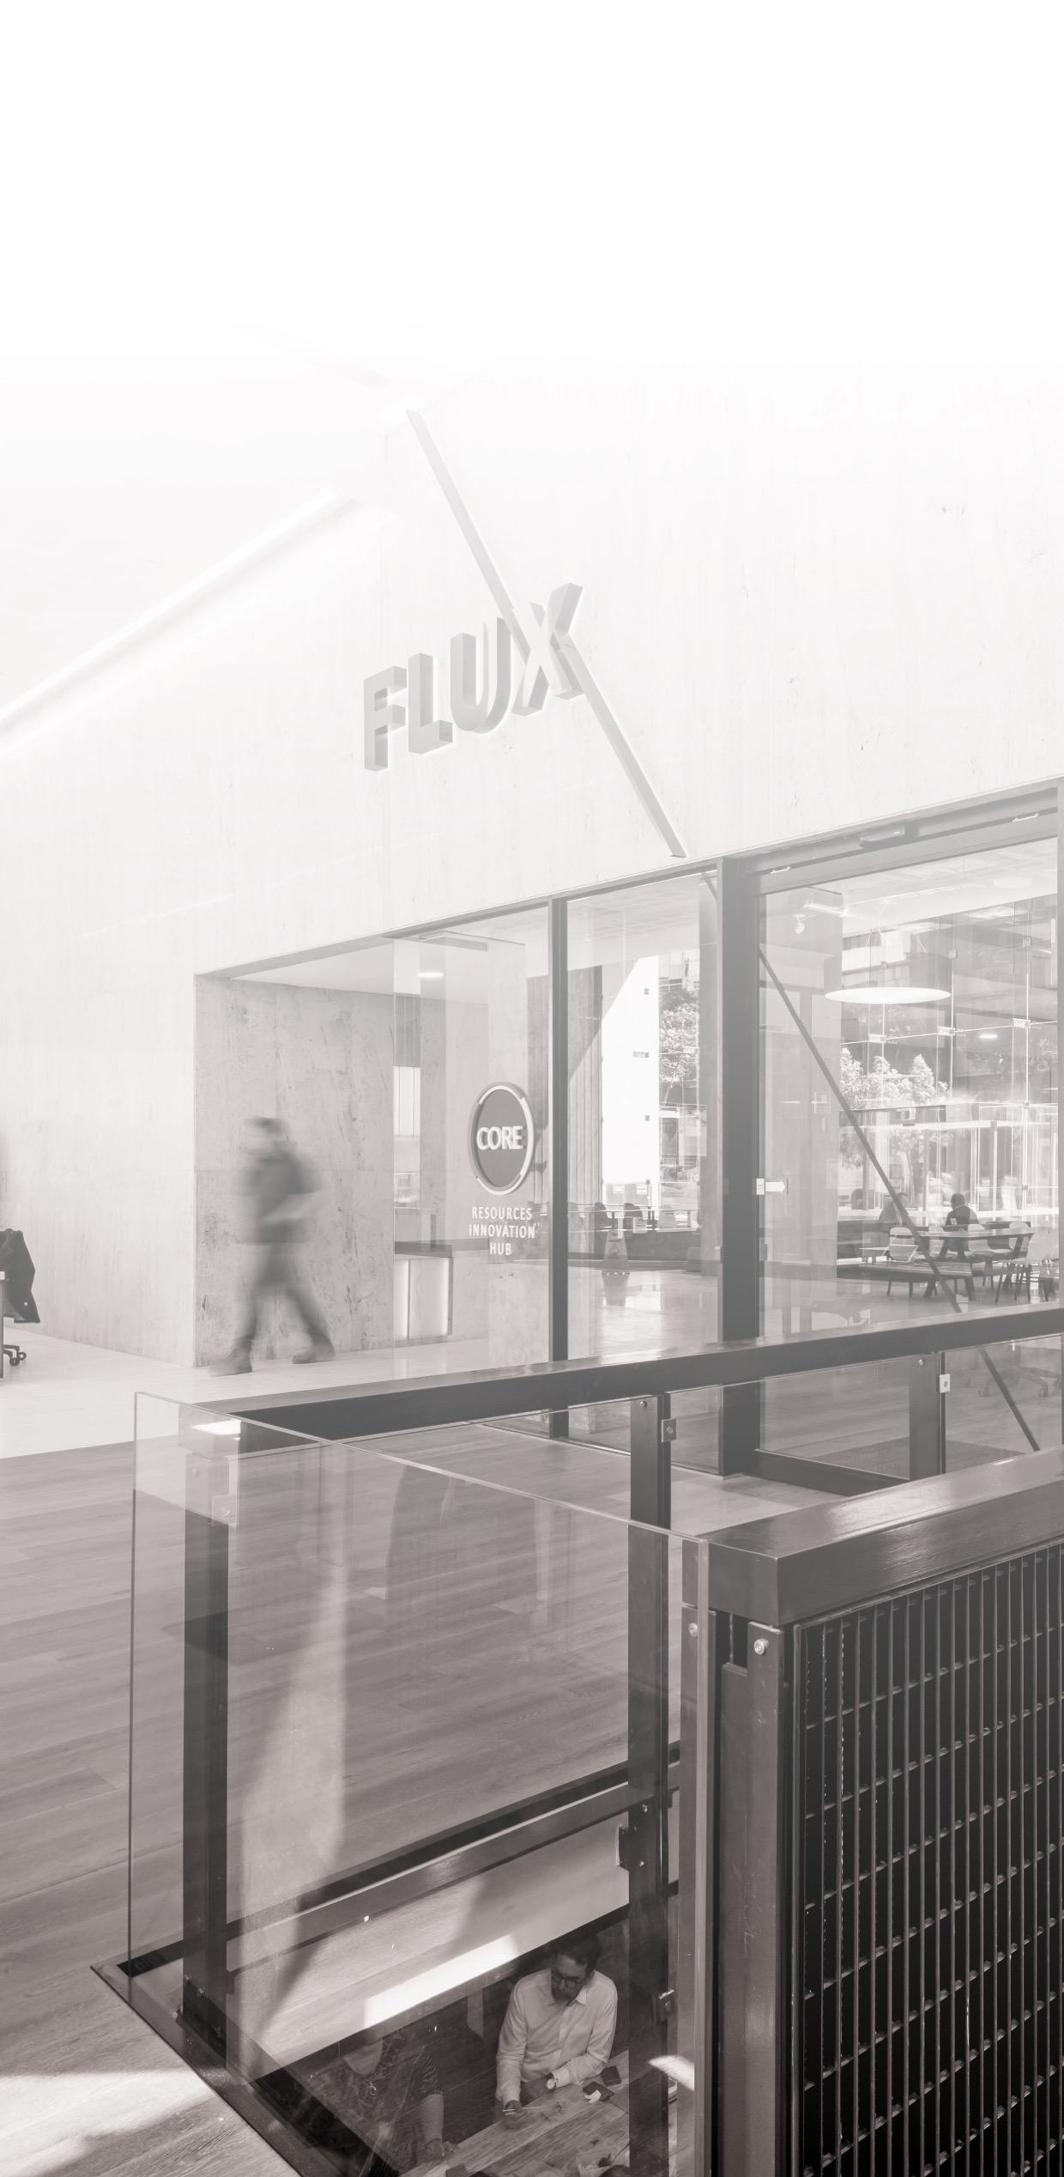


DATA FUSION AND MACHINE LEARNING II:
Recurrent Neural Networks (RNNs)
^{DÉBORA CORRÊA and} ^{AYHAM ZAITOUNY}
^{30 OCT 2018}

Slide 2

^{WHEN TO USE SEQUENCE MODELS?}
Temporal dynamics connecting data samples are important.
Context is important: past samples or decisions influence current predictions.
Share features across different positions of the data is important.
1 - Chandola V, Banerjee A, Kumar V. Anomaly detection: A survey. ACM computing surveys (CSUR). 2009 Jul 1;41(3):15.
2 - Mirikitani DT, Nikolaev N. Recursive bayesian recurrent neural networks for time-series modeling. IEEE Transactions on Neural Networks. 2010 Feb;21(2):262-74.
3 - https://cs.gmu.edu/~xwang24/Projects/RPM.html
4 - Zak, G, et al. Application of ARMA modelling and alpha-stable distribution for local damage detection in bearings, Diagnostyka, 2014.

Slide 3
THE RECURRENT NEURAL NETWORK MODEL
Similar to their feedforward counterpart, but including loop connections, allowing information to persist.
Unrolled recurrent neuron
Layer of unrolled recurrent neurons
Source: Hands on Machine Learning with Scikit-Learn and TensorFlow, Cap. 14.

Slide 4
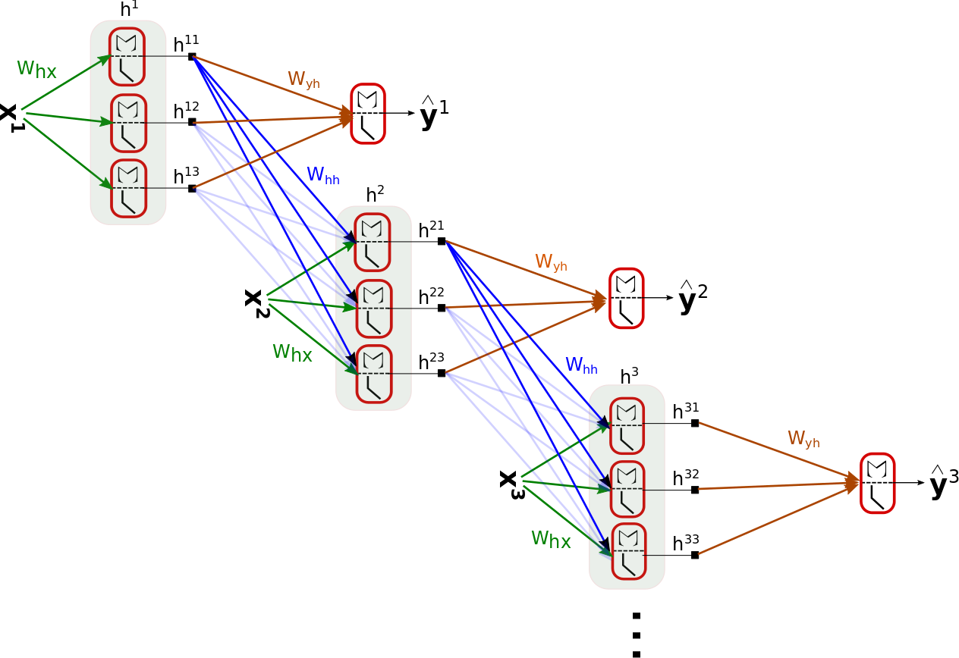
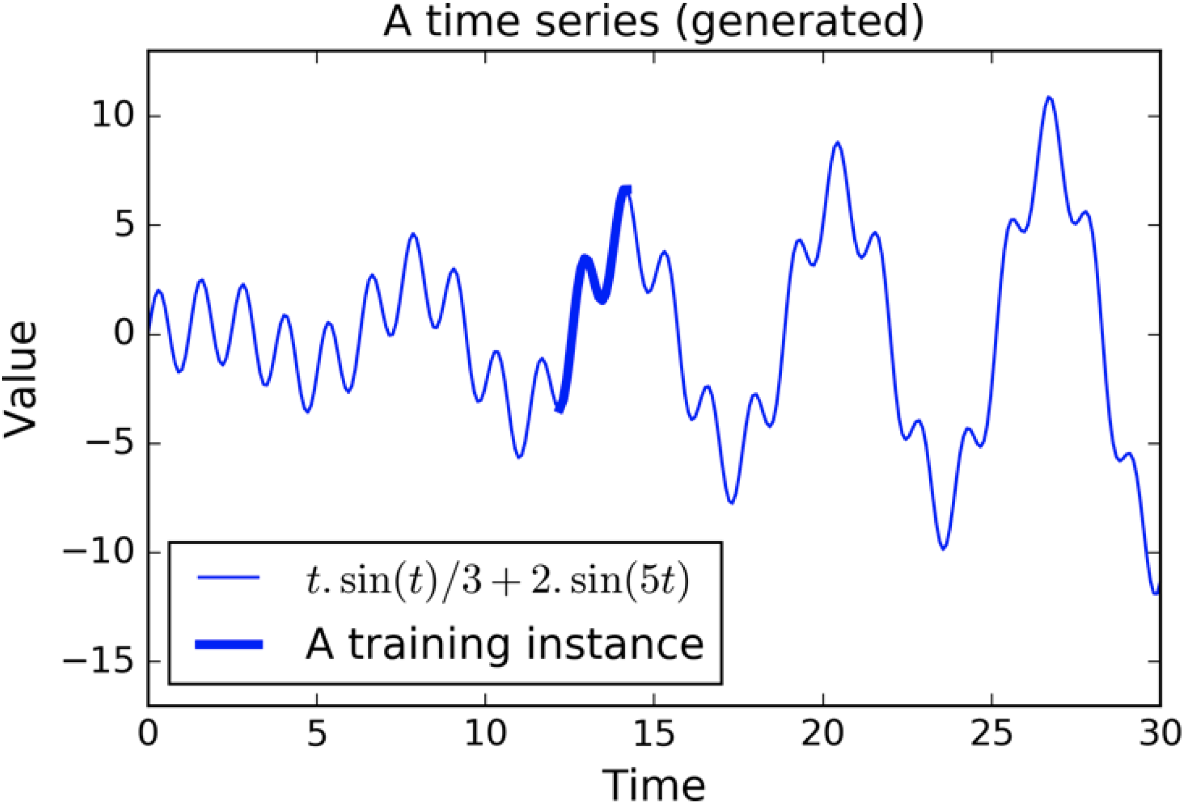
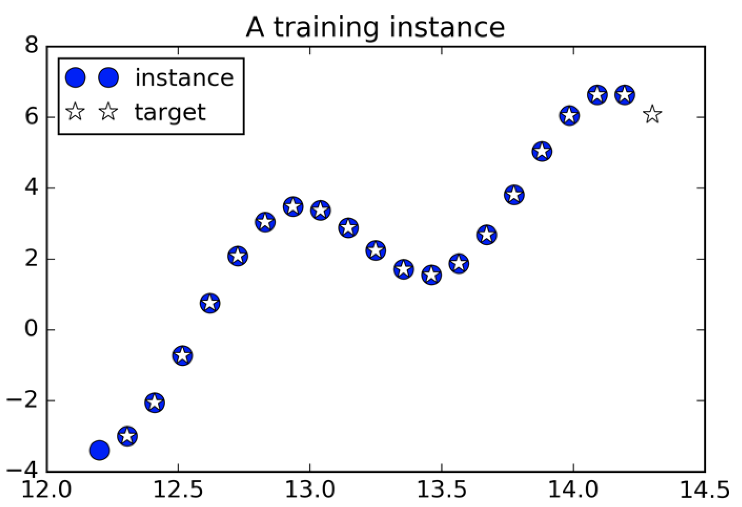
^{THE RNN COMPUTATIONS}
Source: Hands on Machine Learning with Scikit-Learn and TensorFlow, Cap. 14.

Slide 5
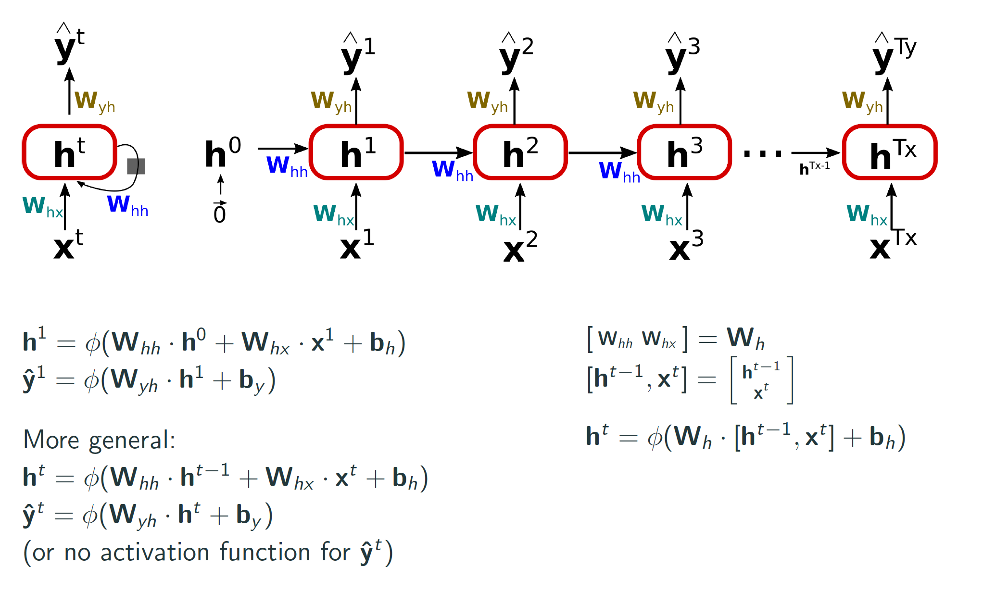
^{THE RNN COMPUTATIONS}
Source: Hands on Machine Learning with Scikit-Learn and TensorFlow, Cap. 14.

Slide 6
^{BACKPROPAGATION THROUGH TIME}
Forward pass: Training instances are fed to the network and output are computed.
Backward pass: Measures the error gradients (in all time steps) with respect to all parameters in the network by (back)propagating the error gradient.
P. J. Werbos, 1990. Backpropagation through time: what it does and how to do it.

Slide 7

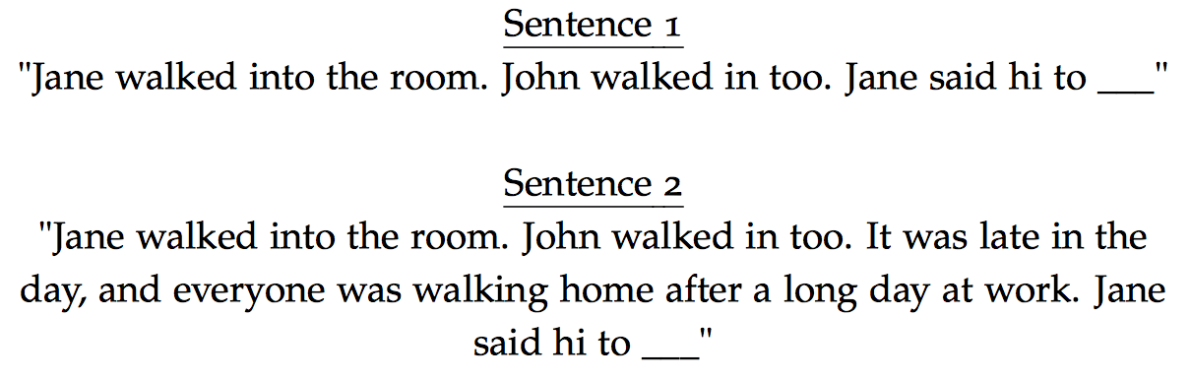
^{VANISHING GRADIENTS}
A basic RNN algorithm very often runs into vanishing gradient problems.
To train it on long sequences, many time steps make the unrolled RNN
similar to a very deep network.
The gradients get smaller and smaller as GD goes down to the lower
layers - for which connection weights remain practically unchanged.
Pascanu et al., 2013. On the difficulty of training recurrent neural networks.
Sentence examples from https://cs224d.stanford.edu/lecture_notes/LectureNotes4.pdf.

Slide 8
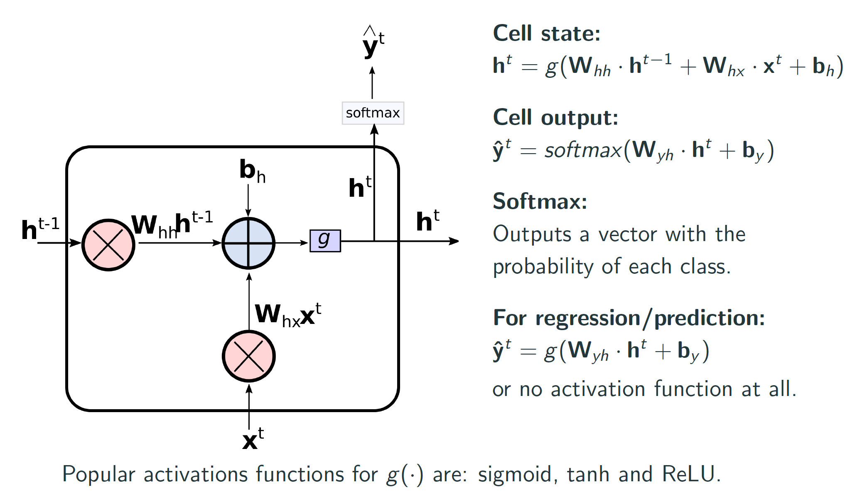
^{ADVANCED RNNS}

Slide 9
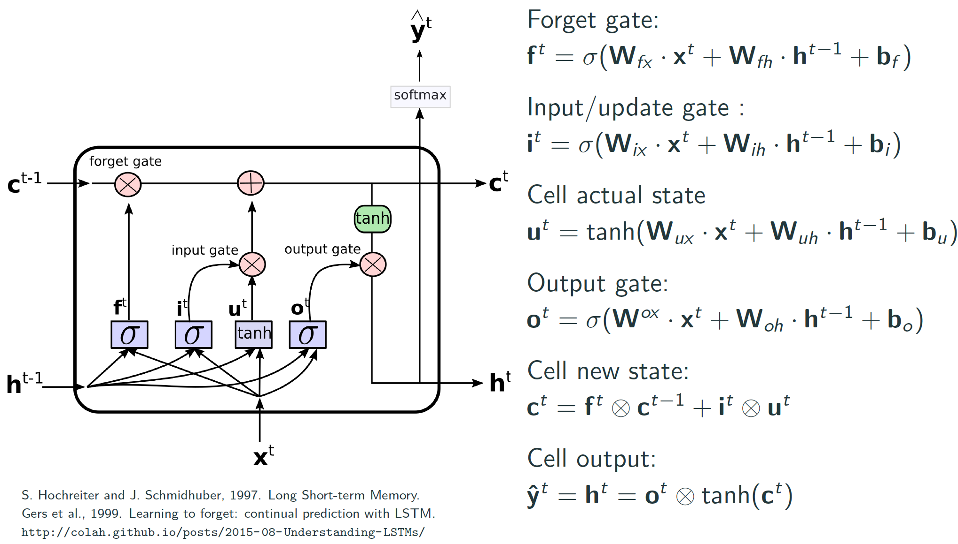
ADVANCED RNNS – LONG SHORT-TERM MEMORY (LSTM)
The LSTM cell learns long-term dependencies in the data, and training usually converge faster than with the basic RNNs.
S. Hochreiter and J. Schmidhuber, 1997. Long Short-term Memory.
Gers et al., 1999. Learning to forget: continual prediction with LSTM.
http://colah.github.io/posts/2015-08-Understanding-LSTMs

Slide 10
ADVANCED RNNS – LSTM FORWARD PASS
The cell state c^{t} is the important aspect of the LSTM: it flows the information related to long-term memories.
The short-term state h^{t} works similar as the basic RNN cell, and its output goes directly to y^{t}.
Variants and improvements:
F.A. Gers and J. Schmidhuber, 2000. Recurrent nets that time and count.
Gers et al., 2002, Learning Precise Timing with LSTM Recurrent Networks.
Zaremba et al., 2015, Recurrent Neural Network Regularization.

Slide 11
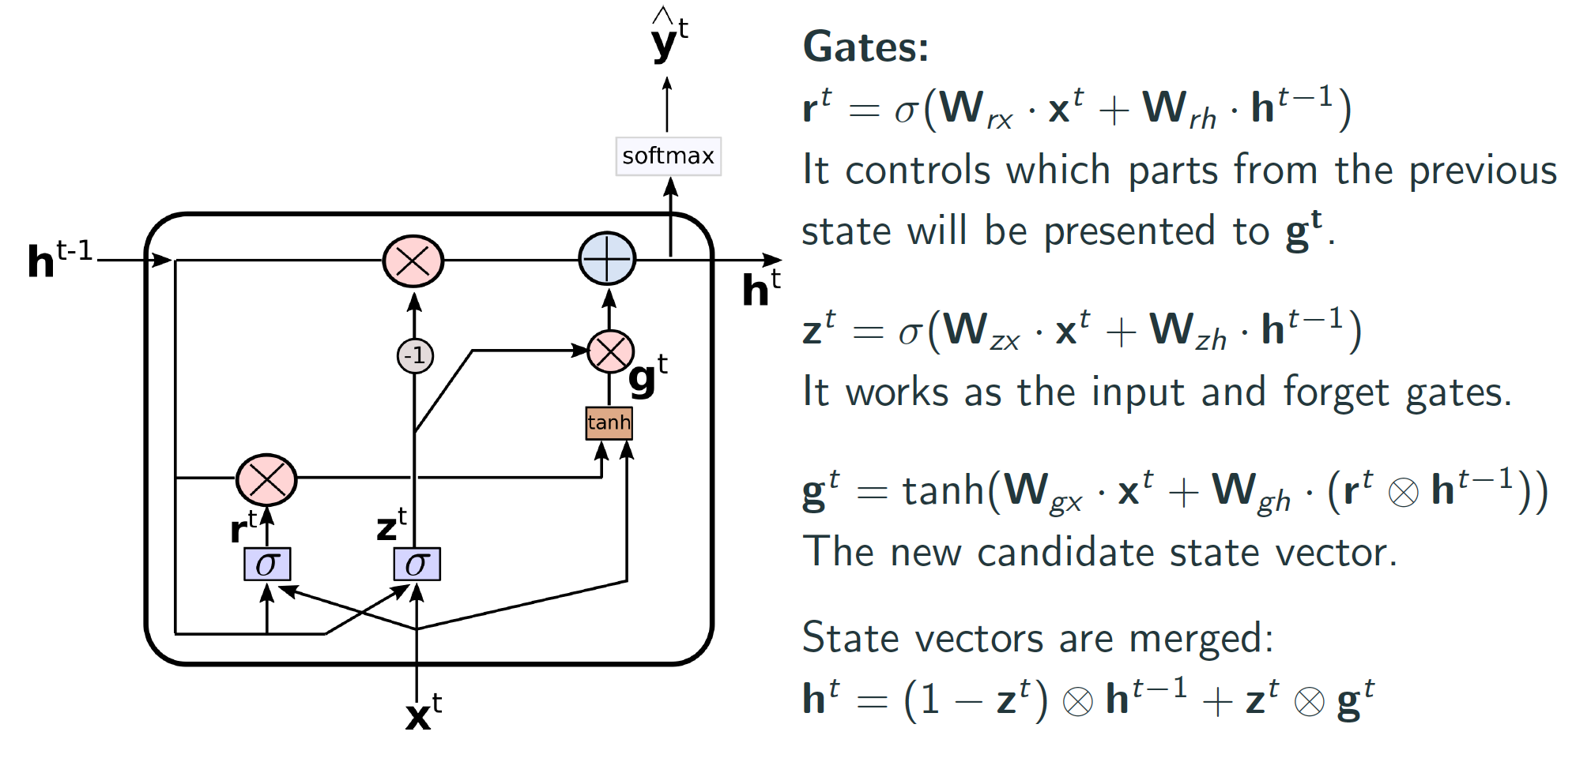
ADVANCED RNNS - GATED RECURRENT UNIT (GRU) CELL
The GRU cell is a simpler (but effective) variant of the LSTM cell.
GRU and LSTM cells have showed similar results for many tasks.
Cho et al., 2014. Learning Phrase Representations using RNN Encoder–Decoder for Statistical Machine Translation.
Cho et al., 2014. On the Properties of Neural Machine Translation: Encoder - Decoder Approaches.
Chung et al., 2014. Empirical evaluation of gated recurrent neural networks on sequence modeling.
Greff et al., 2015. LSTM: A Search Space Odyssey.
Jozefowicz et al., 2015. An Empirical Exploration of Recurrent Network Architectures.

Slide 12
^{TYPES OF RNN}

Slide 13
DISCUSSION: WHAT ARE ANNs POSSIBLE APPLICATIONS IN INDUSTRY?
Use of satellite images (remote sensing) to map the impacts to the environments of mining actives. Aim: identify locations which require attention in order to prevent extreme impact and fine from the government.
Real-time analysis of components in a haul truck for predictive analysis, for instance, to identify whether this component is getting extreme heating when in operation.
Given images from minerals, identify the quality of such materials.
Identification of high risk areas for slips, trips and falls in order to assist with workers' security.
Preventive analysis of fires in underground mines.
Prediction of sky clearness and solar radiations for solar energy applications.
Forecast of electrical energy consumption.

